Slide 1
Spread of Disease
  Factors Affecting the Spread of Disease
Syllabus:
The spread of a specific disease involves a range of interrelated factors, including, growth of the pathogen population, density of the host population and mode of transmission
Transmission and spread of disease is facilitated by regional and global movement of organisms.
The distribution of mosquito-borne diseases may be affected by global climatic changes
Many pathogens evolve rapidly in a changing environment
Susceptibility of urban areas to epidemics and pandemics of infectious disease can be due to population density, variation in living conditions and healthcare provisions (SHE) - this is linked to host factors
Describe how the spread of each of the 10 diseases are affected by:
  The characteristics of the pathogen (life cycle, replication, incubation period)
  Host factors,
  The mode of transmission of the disease
  Evolution of pathogens
Describe how globalisation has lead to an increase in the spread of diseases
Describe how the distribution of RRV and Malaria may be affected by climate change
Essential
Questions:

Slide 2
Spread of Disease
Biology WA UNITS 3 & 4
Reading
Chapter 13 431 – 468
Questions
Set 13.4 page 458 Q1-7
Complete Chapter Review Questions to revise content taught
Biozone
The Nature of Pathogens: 75
The Nature of Pathogens: 76
Vocabulary Check: Define the following terms:
Pathogenicity, virulence, endemic disease, outbreak, epidemic, pandemic and spread
Key Terms | Definition
Pathogenicity
Virulence
Endemic
Outbreak
Epidemic
Pandemic
Spread

Slide 3
Topic Question 1: Describe how a the characteristics of the pathogen can influence the spread of the disease it causes
Growth of Pathogen Population | Virulence | Pathogen Life Cycle | Mode of transmission | Infectious Dose | Evolution
Read page 451 Biology WA ATAR Units 3 & 4 to describe how growth of pathogen population affects the spread of a disease

Slide 4
Topic Question 2: Describe how the mode of transmission of a particular pathogen can influence the spread of disease
Mode of Transmission | Example | Example of Disease | How Disease is transmitted | Effect on the Spread of the Disease
Direct Contact (Direct Transmission) | Through direct contact with bodily fluids (i.e. sperm, blood) | HIV | Spread through direct contact between an affected host & susceptible host Spread though direct contact with bodily fluids through sexual transmission | Spread influenced by host behavior Spread faster when certain behaviour are common (unprotected sex)
Close Contact (Direct Transmission) | Contact transmission or airborne droplets | Influenza, TB |  | Spread influenced by host behaviors Spread influenced by host density
Reservoir (Direct Transmission) | Transmission via contact with an inanimate reservoir such as soil which is a reservoir for tetanus bacteria | Tetanus

Slide 5
Topic Question 2: Describe how the mode of transmission of a particular pathogen can influence the spread of disease
Mode of Transmission | Example | Example of Disease | How Disease is transmitted | Effect on the Spread of the Disease
Water/Soil/Food borne (Indirect transmission) |  | Chytrid, Dieback, Bovine TB
Vector (Indirect transmission) |  | Malaria, Ross River Virus
Fomite & Airborne droplets (aerosols) (Indirect transmission) |  | Influenza

Slide 6
Practice Exam Question
Using bees as an example, explain the difference between direct and indirect transmission of disease. 4 marks)

Slide 7
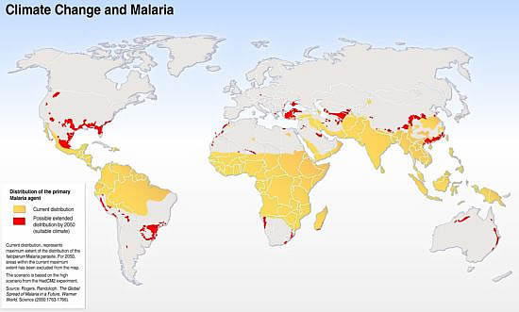
Topic Question 3: Describe how the environment the host population is living in can influence the spread of disease
Environment
Globalisation
Urbanisation
Climate Change
Infrastructure

Slide 8
Topic Question 4: Describe how different host factors can influence the spread of disease
Population density
Variation in living conditions
Healthcare provisions
Susceptibility is due to the following

Slide 9
Sum it up!
Disease | Factors Affecting the Spread of the Disease
 | Pathogen (growth of the pathogen, life cycle – dormant period?, incubation period, | Evolution – resistance to drugs | Mode of Transmission | Environment (globalisation, urbanisation, infrastructure) | Climate Change | Host Population (host density, living conditions, healthcare provisions)

Slide 10
Sum it up!
Disease | Factors Affecting the Spread of the Disease
 | Pathogen (growth of the pathogen, life cycle – dormant period?, incubation period, | Evolution – resistance to drugs | Mode of Transmission | Environment (globalisation, urbanisation, infrastructure) | Climate Change | Host Population (host density, living conditions, healthcare provisions)

Slide 11
Sum it up!
Disease | Factors Affecting the Spread of the Disease
 | Pathogen (growth of the pathogen, life cycle – dormant period?, incubation period, | Evolution – resistance to drugs | Mode of Transmission | Environment (globalisation, urbanisation, infrastructure) | Climate Change | Host Population (host density, living conditions, healthcare provisions)

Slide 12
Sum it up!
Disease | Factors Affecting the Spread of the Disease
 | Pathogen (growth of the pathogen, life cycle – dormant period?, incubation period, | Evolution – resistance to drugs | Mode of Transmission | Environment (globalisation, urbanisation, infrastructure) | Climate Change | Host Population (host density, living conditions, healthcare provisions)

Slide 13
Sum it up!
Disease | Factors Affecting the Spread of the Disease
 | Pathogen (growth of the pathogen, life cycle – dormant period?, incubation period, | Evolution – resistance to drugs | Mode of Transmission | Environment (globalisation, urbanisation, infrastructure) | Climate Change | Host Population (host density, living conditions, healthcare provisions)

Slide 14
Practice Exam Questions

